Slide 1
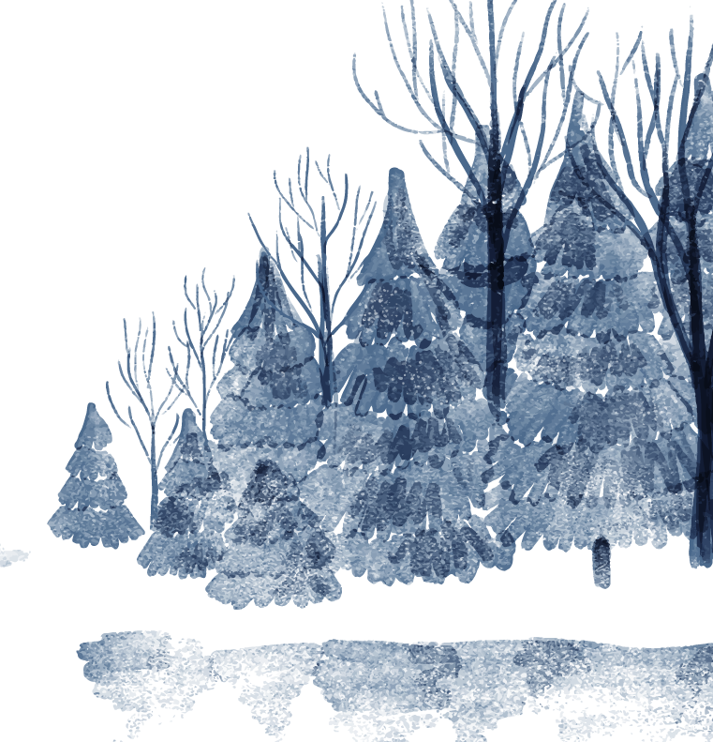
Хранители Арктики
Бот для изучения малых народов севера

Slide 2
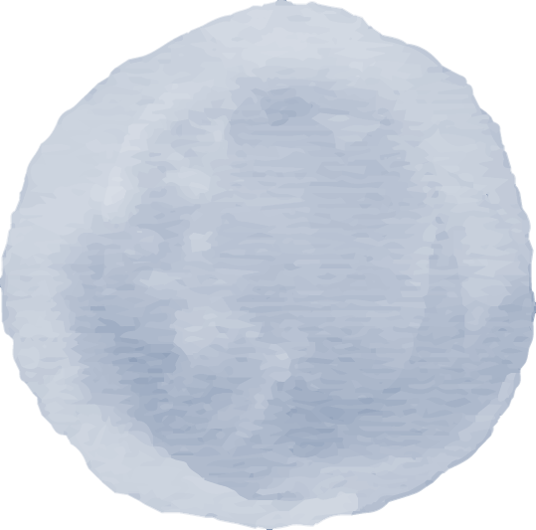
Проблемы
Малая известность
Venus
Mercury is the closest planet to the Sun and the smallest one in the Solar System. This planet’s name has nothing to do with the liquid metal
Venus has a beautiful name and is the second planet from the Sun. It’s hot and is the second-brightest natural object in the night sky

